Slide 1
System Analysis and Design Lab
Sign Language Software Management System
Md Mehedi Islam(21201065)
Jannatun Saumoon (21201066)
Paria Chowdhury (21201067)
Labanya Saha (21201059)
Submitted To:-
Muhtasim Noor Alif
Lecturer, UAP (CSE)

Slide 2
System Requirements
User Features
Registration and Profile Creation
Account management
Personalized dashboard
payment processing
Learning Plans and Lesson Structure
Learning Modules and Practice Sessions
Offline Access
Help and Support
Achievements and Badges
Progress Tracking
Notification system

Slide 3
System Requirements
Admin Features
Dashboard overview of system activity
User Profile management
Content Management
Reporting and Analytics
Backup and Recovery
Training and Support
Communication Tools
payment processing
Security Management

Slide 4
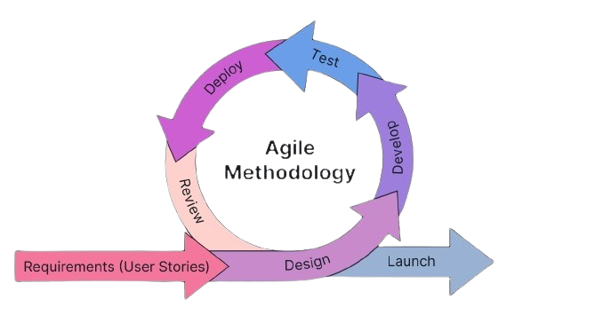
Reasons for choosing Agile methodology
Flexibility
User-Centric Approach
Efficiency
Continuous Improvement
Empowered Teams
Iterative Feedback

Slide 5
Agile Methodology Phases
Planning- In this phase, we will define the scope of the project, and create a project plan.
Requirement - we will gather requirements from the users, including the specific features and functionalities needed for the Sign Language Software Management System.
Design- we will design the system architecture, user interface, and database schema based on the gathered requirements.
Development- we will develop the software, including coding, testing, and debugging.

Slide 6
Integration: we will integrate the developed components into the overall system and test the integration.
Testing: we will perform thorough testing of the system to ensure it meets the requirements and is free of bugs.
Deployment: we will deploy the system to the production environment and make it available to users.
Maintenance: we will provide ongoing maintenance and support for the system, including bug fixes, updates, and enhancements.

Slide 7
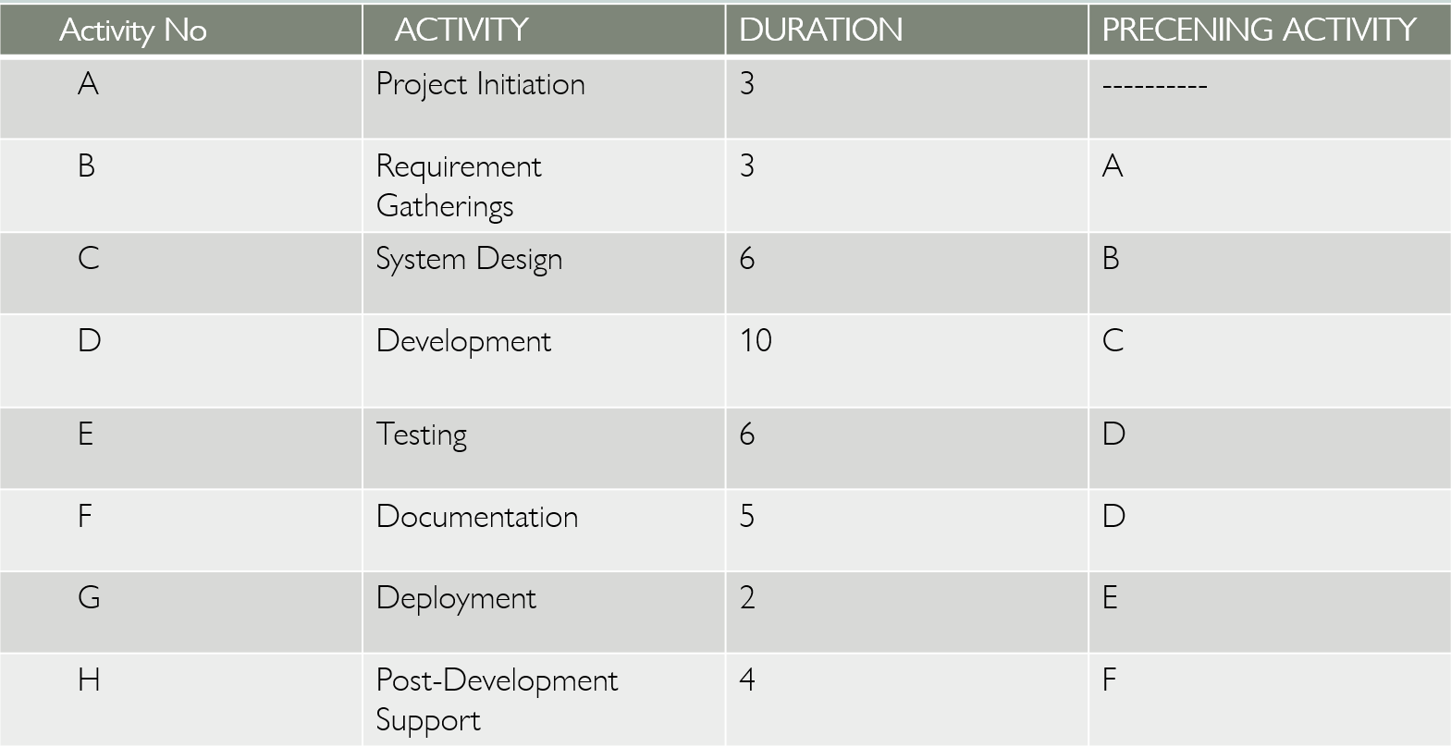
Project Scheduling (CPM
Sequence of Activity

Slide 8
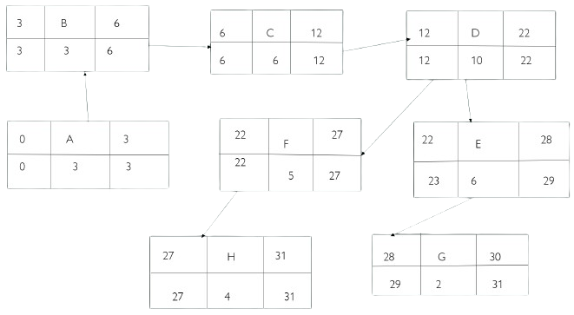
Critical Path Method Diagram

Slide 9
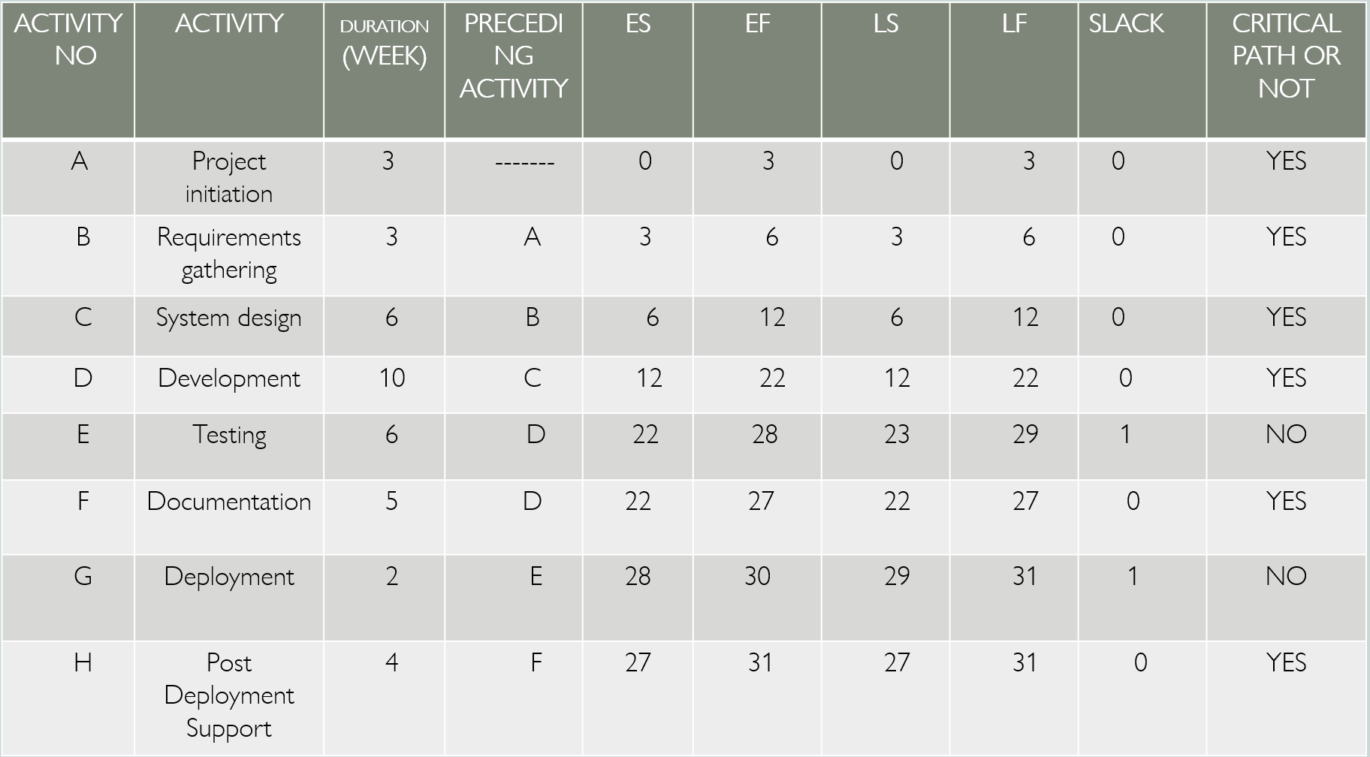
FORWARD, BACKWARD PASS & CRITICAL PATH CALCULATION

Slide 10




